Slide 1
4:1-7

Slide 2
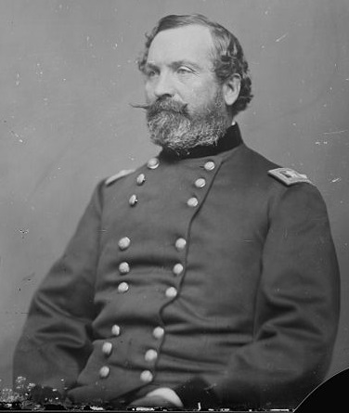
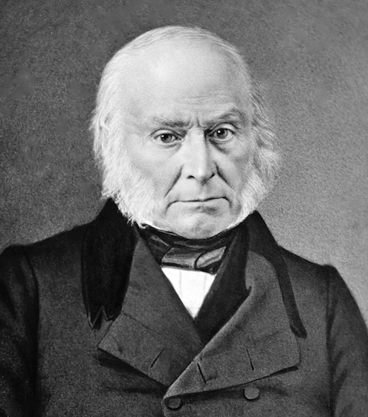
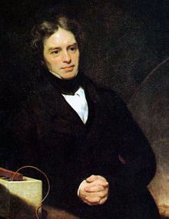
4:1-7
Gen. John Sedgwick, during the Battle of Spotsylvania Courthouse (d. 1864) ~
“They couldn’t hit an elephant at this dist .... ”
John Quincy Adams, 6th president of the U.S. (d. 1848) ~
“This is the last of earth. I am content.”
Michael Faraday, pioneer in electrochemistry (d. 1867) ~
“I shall be with Christ, and that is enough.”

Slide 3
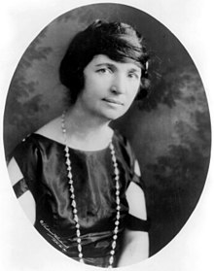
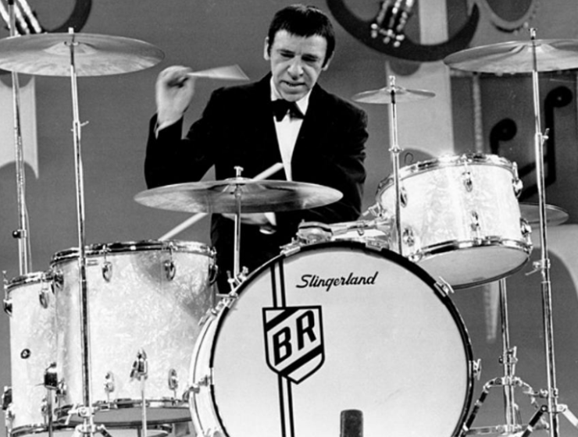
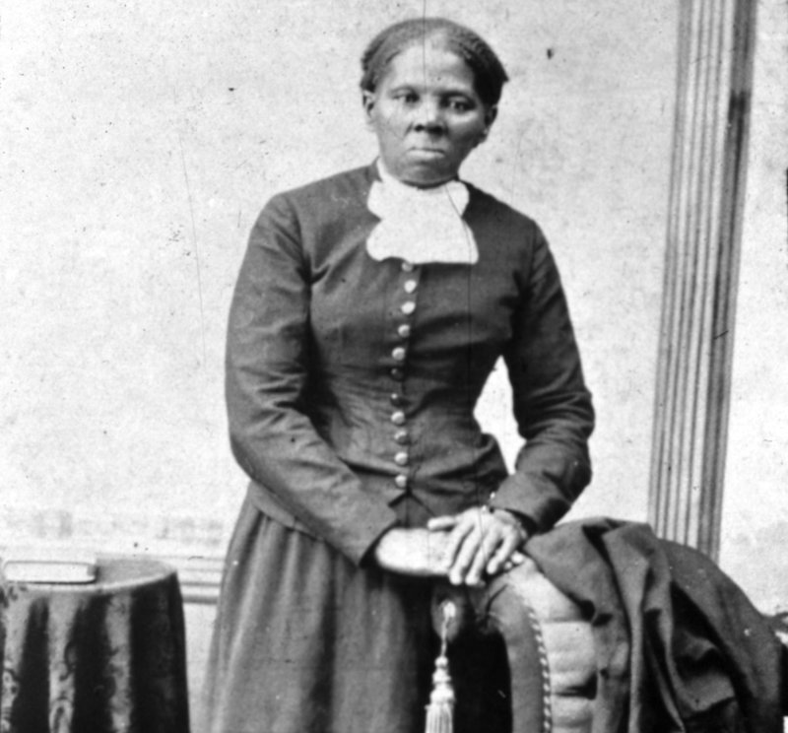
4:1-7
Margaret Sanger, Planned Parenthood founder and eugenics advocate
(d. 1966) ~
“A party! Let’s have a party.”
Drummer Buddy Rich (when his nurse asked him if there was anything he couldn’t take) (d. 1986) ~
“Yeah, Country Music.”
Harriet Tubman, founder of the Underground Railroad
(d. 1913) ~
“Sweet low, sweet chariot”

Slide 4
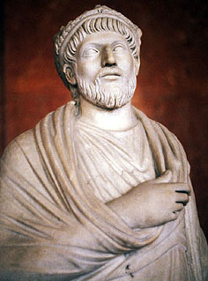
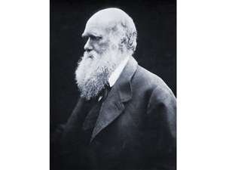
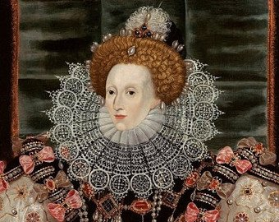
4:1-7
Julian the Apostate (d. AD 363) ~
“You have won, O Galilean.”
Charles Darwin (d. 1886) ~
“I am not the least afraid to die.”
Queen Elizabeth I (d. 1603) ~
“All my possessions for a moment of time.”

Slide 5
4:1-7
Lea Etta Merrihew (d. 1993) ~
“So many wasted years”

Slide 6
4:1-7

Slide 7
4:1-7
2 Timothy 4:1–7 ~ ¹ I charge you therefore before God and the Lord Jesus Christ, who will judge the living and the dead at His appearing and His kingdom: ² Preach the word! Be ready in season and out of season. Convince, rebuke, exhort, with all longsuffering and teaching. ³ For the time will come when they will not endure sound doctrine, but according to their own desires, because they have itching ears, they will heap up for themselves teachers; ⁴ and they will turn their ears away from the truth, and be turned aside to fables.

Slide 8
4:1-7
2 Timothy 4:1–7 ~ ⁵ But you be watchful in all things, endure afflictions, do the work of an evangelist, fulfill your ministry. ⁶ For I am already being poured out as a drink offering, and the time of my departure is at hand. ⁷ I have fought the good fight, I have finished the race, I have kept the faith.

Slide 9
4:1-7

Slide 10
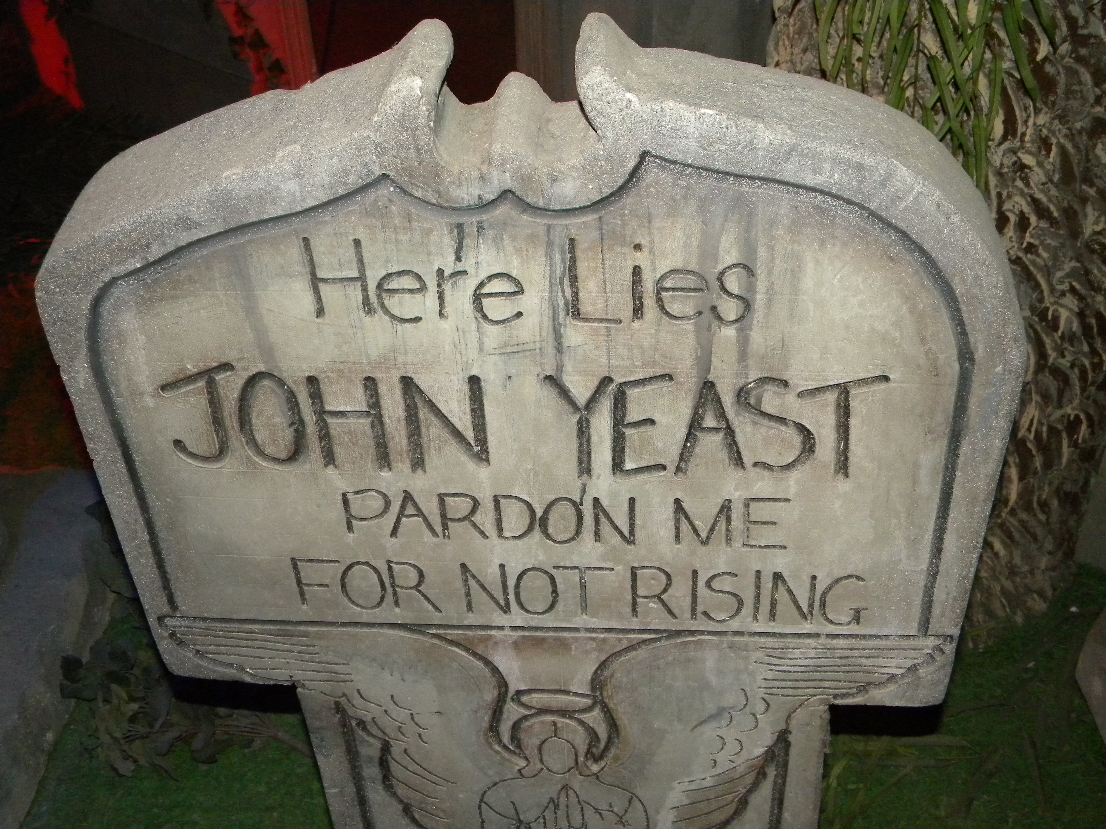
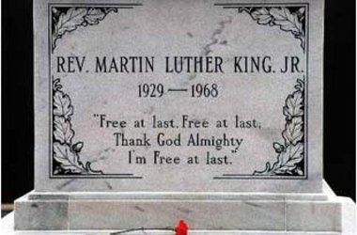
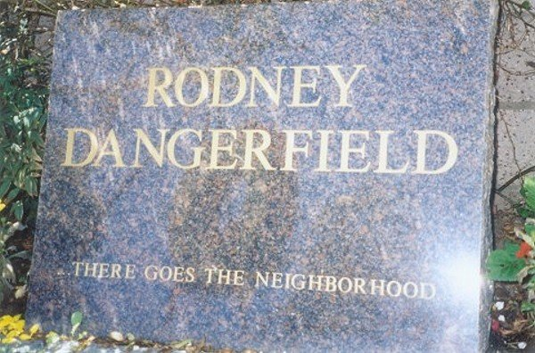
4:1-7
In a graveyard in Riudoso, NM ~ “Here lies John Yeast. Pardon me for not rising”
Martin Luther King Jr. ~ “Free at last. Free at last. Thank God Almighty I’m free at last”
Rodney Dangerfield ~ “There goes the neighborhood”

Slide 11
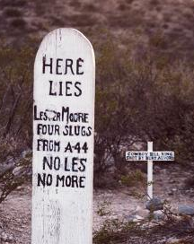
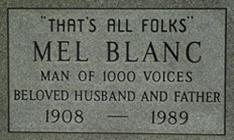
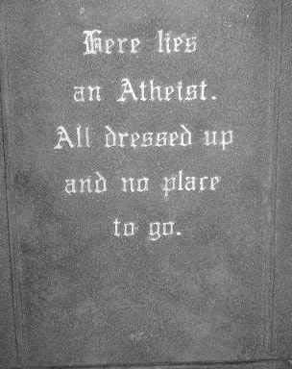
4:1-7
Boot Hill Cemetery, Tombstone, AZ~ “Here lies Les More. Four slugs from a .44. No Les, no more”
Mel Blanc – The voice of Woody Woodpecker, Bugs Bunny, Yosemite Sam and many, many others ~ “That's all folks”
Cemetery in Thurmont, Maryland ~ “Here lies an atheist. All dressed up and no place to go”

Slide 12
4:1-7

Slide 13
4:1-7
I, Linus P. Bigbux, being of sound mind and sound body, to hereby bequeath the following:
To my beautiful daughter, Jessica, the apple of my eye, I leave the yacht, the summer cottage and $1,000,000
The
Last Will
To my faithful wife, Rose, who has stayed by my side all these years, I leave the house, the company and $2,000,000
~~~((( and )))~~~
To my cousin, Dan who hated me, argued with me, didn’t believe I would mention him in my will
Testament
of
Linus P. Bigbux
– you’re wrong.
Hi Dan.

Slide 14
4:1-7

Slide 15
4:1-7
2 Timothy 4 = Paul’s epitaph
2 Timothy = Paul’s Swan Song

Slide 16
4:1-7

Slide 17
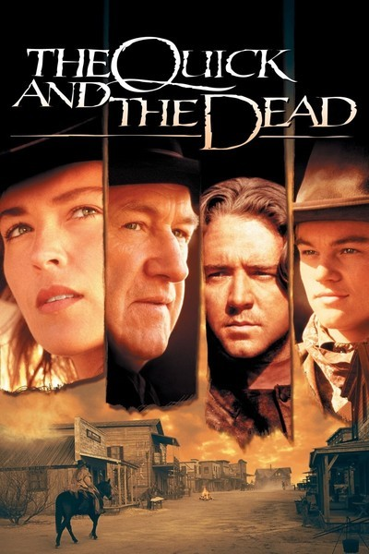
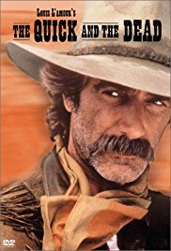
4:1-7
charge ~ diamarturomai
dia ~ through (when used as a prefix, serves to intensify word)
martus ~ martyr – a witness
i.e. a very strong witness
living and the dead ~ KJV, quick and the dead

Slide 18
4:1-7

Slide 19
4:1-7
about
Preach
from
the word!
John 21:16 ~ tend (feed, nourish, care for) – poiman (verb form of the noun shepherd)
Be ready ~ literally, to stand upon
in season ~ eukairōs – good time
out of season ~ akairōs – not time
When it’s convenient and when it’s not convenient

Slide 20
4:1-7

Slide 21
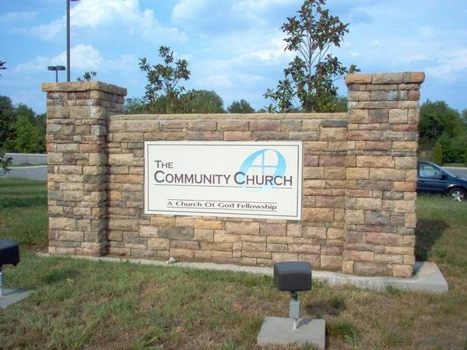
4:1-7
THE
3/4
FIRST GOSPEL
CHURCH

Slide 22
4:1-7
THE
3/4
FIRST GOSPEL
CHURCH

Slide 23
4:1-7
Worship was off
A/C
was off
Pastor was off
1/2
1/4
3/4
Pastor was on
Worship was on
empty
full
gospel-o-meter

Slide 24
4:1-7
Is. 30:8-11 ~ ⁸ Now go, write it before them on a tablet,
And note it on a scroll,
That it may be for time to come,
Forever and ever:
⁹ That this is a rebellious people,
Lying children,
Children who will not hear the law of the Lord;
¹⁰ Who say to the seers, “Do not see,”
And to the prophets, “Do not prophesy to us right things;
Speak to us smooth things, prophesy deceits.

Slide 25
4:1-7
Is. 30:8-11 ~ ¹¹ Get out of the way,
Turn aside from the path,
Cause the Holy One of Israel
To cease from before us.”

Slide 26
4:1-7

Slide 27
4:1-7
John Randall (CC San Juan Capistrano) ~ “Today, many people would rather endure ‘sound bytes’ rather than ‘sound doctrine.’”
heap up ~ literally, heaps upon heaps
Joe Focht (CC Philly) ~ “They will be more concerned with the length of your sermon than they are with the depth of your sermon. They will be more concerned with, ‘How can God serve me?’ than ‘How can I serve God?’”

Slide 28
4:1-7
Seneca the Younger (4 BC – AD 65, as he observed Christian gatherings) ~ “Some come to hear, not to learn, just as we go to the theatre, for pleasure, to delight our ears with the speaking or the voice of the plays.”
a
= to not
, un
muse
=
think

Slide 29
4:1-7
David Guzik (CC Santa Barbara) ~ “When you have hearers with itching ears, you will have preachers with itching palms - wanting to be scratched by money, and satisfy the ‘market’ of itching ears.”
Philip Yancey ~ “If God consistently sent lightning bolts in response to bad doctrine, our planet would sparkle nightly like a Christmas tree.”

Slide 30
4:1-7

Slide 31
4:1-7
truth ~ 6x – 2:15, 2:18, 2:25; 3:7, 3:8 and 4:4
1. Jesus paid for our sins
2. We are joint-heirs
3. We are princes and princesses
4. We should live like kings
5. We should live like gods
Itching ears become deaf ears

Slide 32
4:1-7

Slide 33
4:1-7
watchful ~ nēphō – without wine
endure afflictions ~ kakopatheō
kakos ~ bad, evil
pathos ~ suffering

Slide 34
4:1-7

Slide 35
4:1-7
poured out ~ spendō – (spend) Paul was being “spent”
departure ~ analusis – (analysis) an unloosing of things woven; used of a ship leaving the dock
C. H. Spurgeon ~ “Paul is resolved to show his thankfulness to Christ, the great sacrifice, and he is willing that his blood should be poured as a drink offering on the altar where his Lord and Master was the great burnt offering.”

Slide 36
4:1-7

Slide 37
4:1-7
fought ~ agōnizomai (agony)
Jude 1:3 ~ contend earnestly for the faith …

Slide 38
4:1-7
fought ~ agōnizomai (agony)
Jude 1:3 ~ contend earnestly for the faith …
fight ~ agōn – “I contended well”
agōnizomai-er

Slide 39
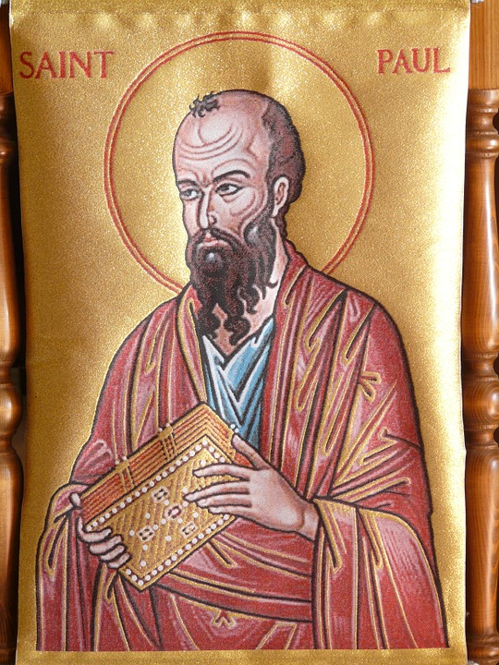
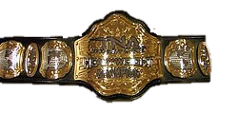
4:1-7
FGF
“Fighting the Good Fight” World Champeen
FGF

Slide 40
4:1-7

